Slide 1
RDBMS for Cloud Computing
Jannatun Noor, Lecturer
BRAC University

Slide 2
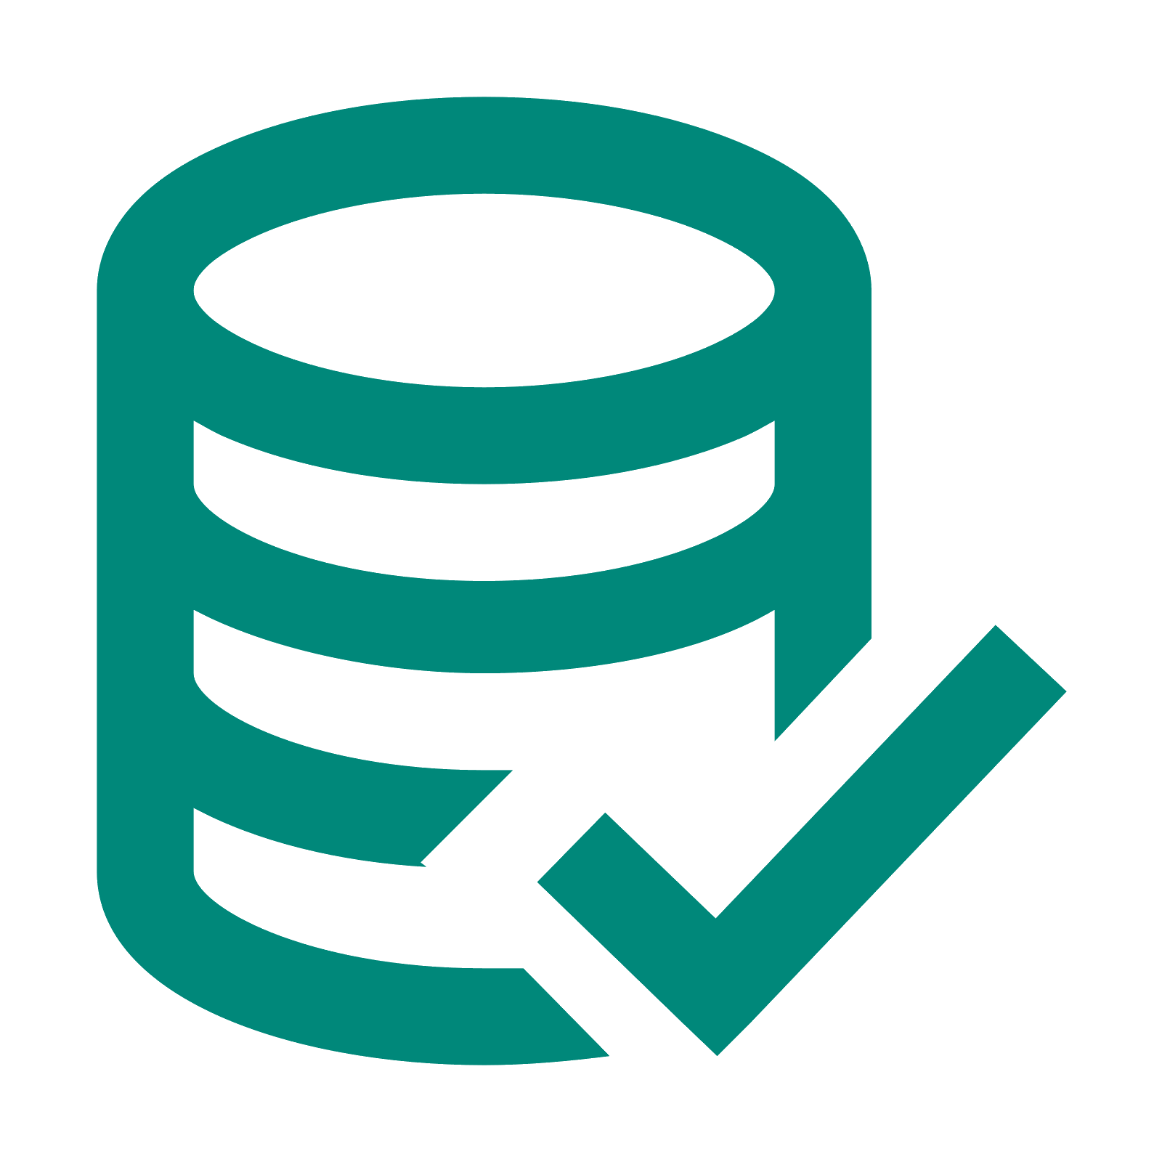
WHAT IS DATABASE?
A database is a collection of related data which represents some aspect of the real world
Example -
Telephone directory
Classroom attendance sheet
BRTA vehicle registration records
Banking records
University registration and grades
Reservations and schedules

Slide 3
TYPES OF DATABASE
Personal database
Commercial database
Relational database
Distributed database
Cloud database
Centralised database
NoSQL database
Object-oriented database
Operational database
Graph database

Slide 4
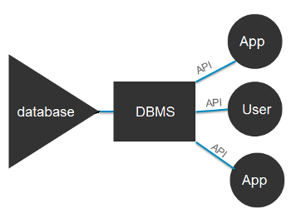
WHAT IS DBMS?
A database management system (DBMS) is system software for creating and managing databases
Provides convenient environment to user to perform operations
Creation, Insertion, Deletion
Updating & Retrieval of information

Slide 5

ADVANTAGES OF DBMS
Controlling Data Redundancy
Data Consistency
Control Over Concurrency
Backup and Recovery Procedures
Data Independence

Slide 6

DISADVANTAGES OF DBMS
Cost of hardware and software
Cost of data conversion
Cost of staff training
Appointing technical staff
Database damage

Slide 7
WHAT IS RDBMS?
A relational database management system (RDBMS or just RDB) is a common type of database that stores data in tables, so it can be used in relation to other stored datasets
Simple and sound theoretical basis
Based on tables, rows and columns and manipulation of data stored within it
Relational database is a collection of these tables
Main feature: Single database can be spread across several tables

Slide 8

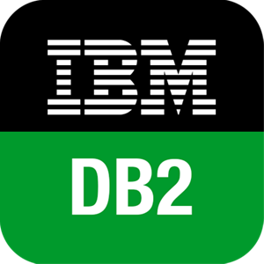
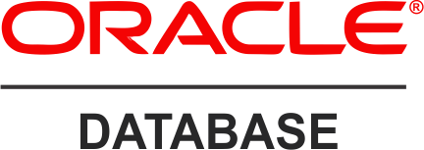
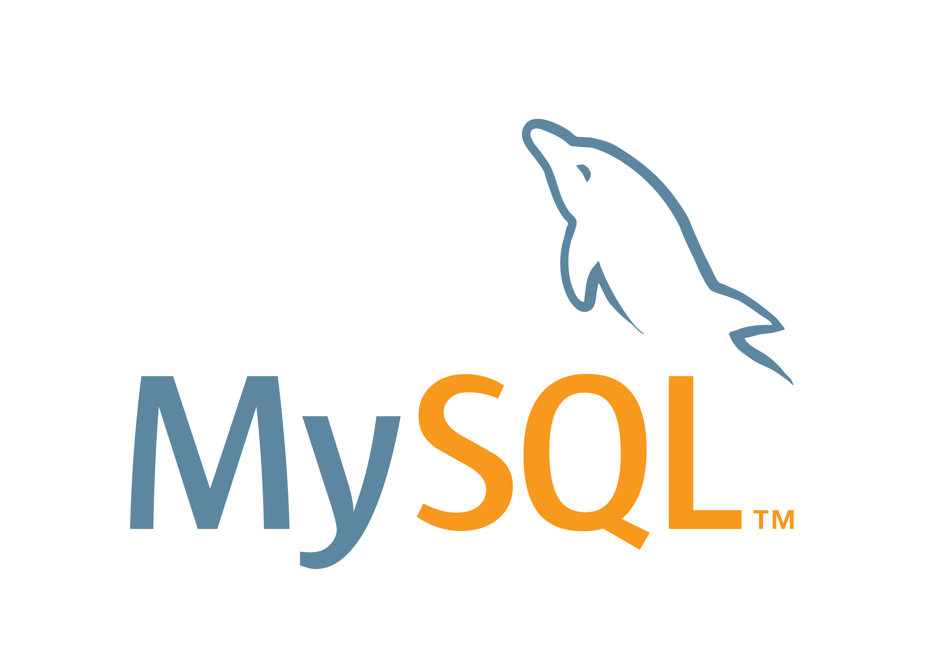
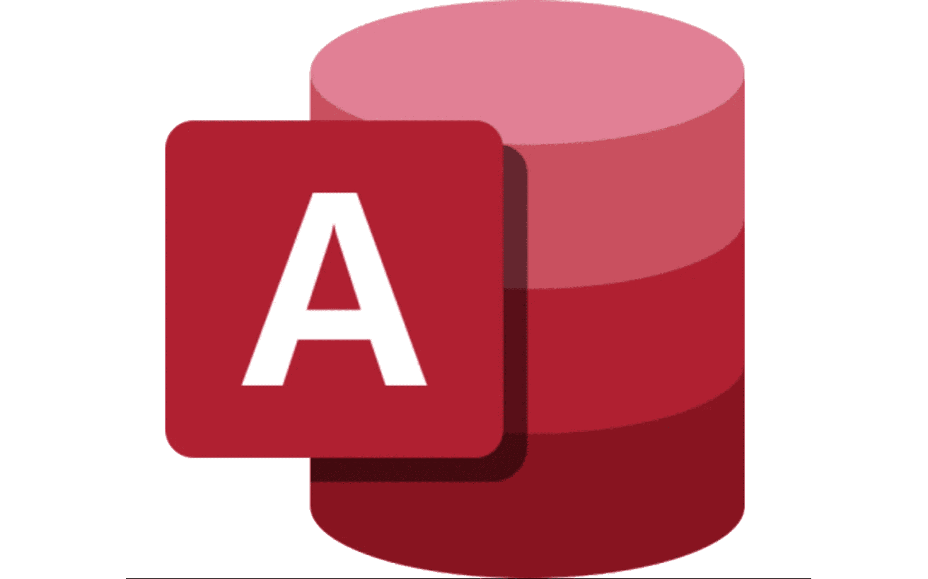
Examples of RDBMS
Oracle Database
IBM's DB2
PostgreSQL
MySQL
Microsoft Access

Slide 9
ADVANTAGES OF RDBMS
Simple data structure
Provides physical data independence
Provides multiple interfaces
Multiple user accessibility
Expandability is relatively easy to achieve

Slide 10
DISADVANTAGES OF RDBMS
Software is expensive
Requires skilled knowledge to implement
Difficult to recover if data is lost
Difficult to represent complex data type
Certain applications are slower processing

Slide 11
WHAT IS NON-RDBMS?
Non-relational databases often called NoSQL databases
Stores data in a non-tabular form
Used in large quantities of complex and diverse data organization
Performs faster because a query doesn’t have to view several tables

Slide 12
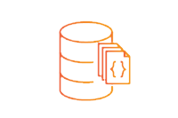
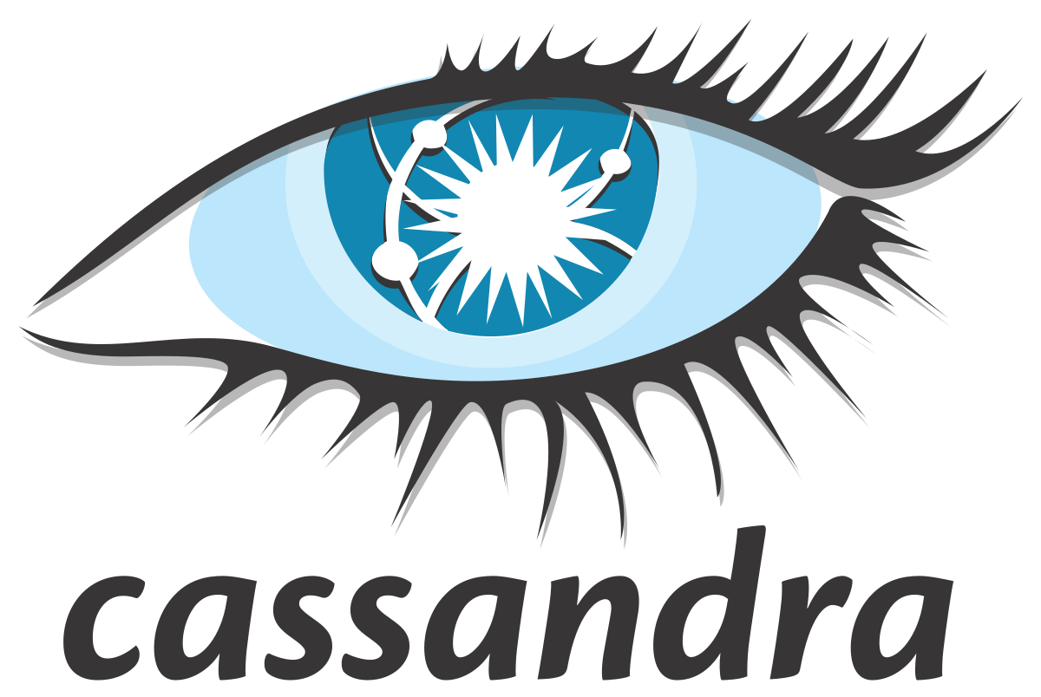
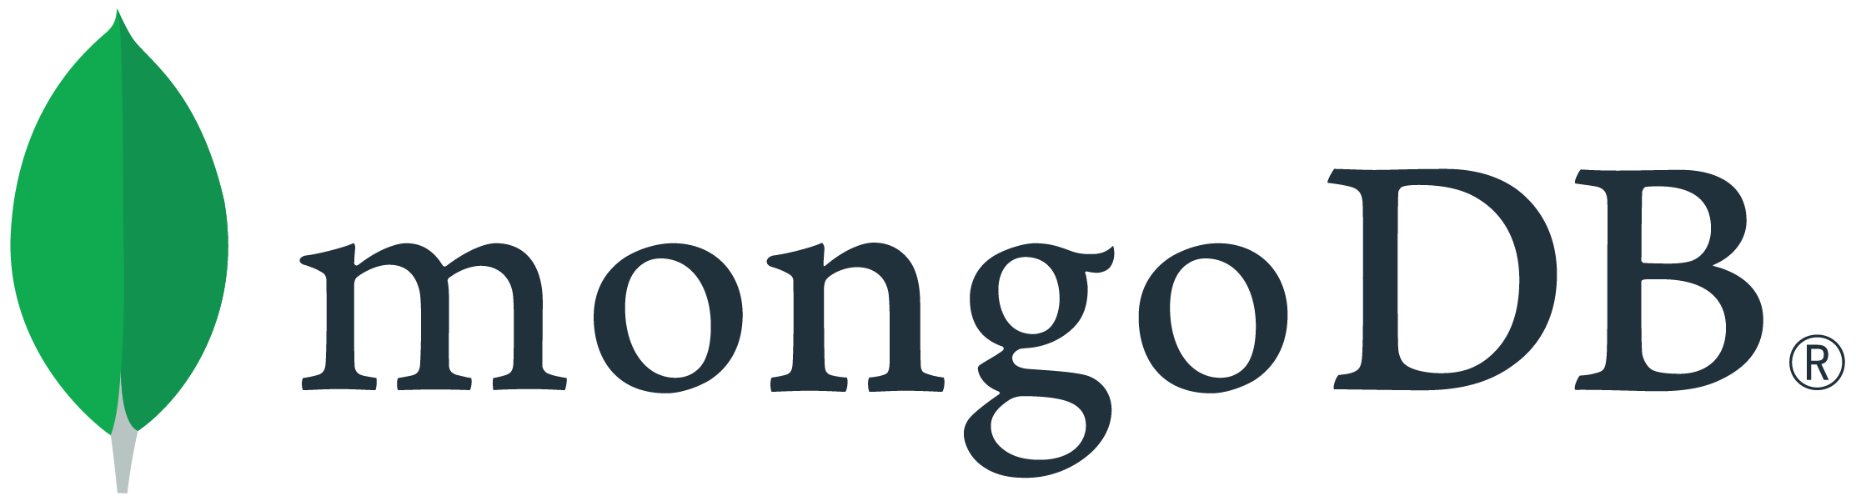
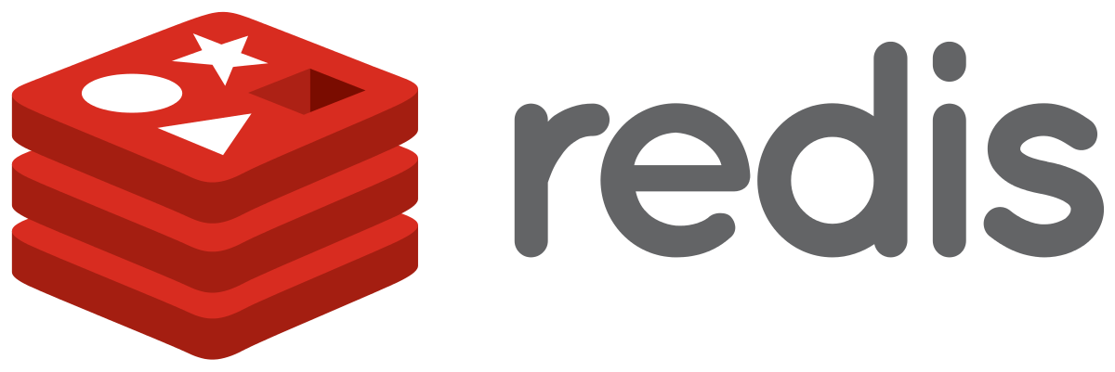

Examples of NON-RDBMS
MongoDB
Amazon DocumentDB
Apache Cassandra
Redis
Apache CouchDB

Slide 13
DIFFERENCE BETWEEN RDBMS AND NON-RDBMS
Data uses Schemas
Have relations
Data is distributed across multiple tables
Horizontal scaling is impossible, vertical scaling is possible
Limitations for lots of read and write queries per second
Schema-less
No (or very few) Relations
Data is typically merged /nested in a few collections
Both horizontal and vertical scaling is possible
Great performance for mass read and write

Slide 14
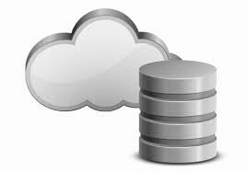
WHAT IS CLOUD COMPUTING?
Cloud computing is the delivery of different services through the Internet. These resources include tools and applications like data storage, servers, databases, networking, and software
Types of Cloud Services
Email
Storage, backup, and data retrieval
Creating and testing apps
Analyzing data
Audio and video streaming
Delivering software on demand

Slide 15


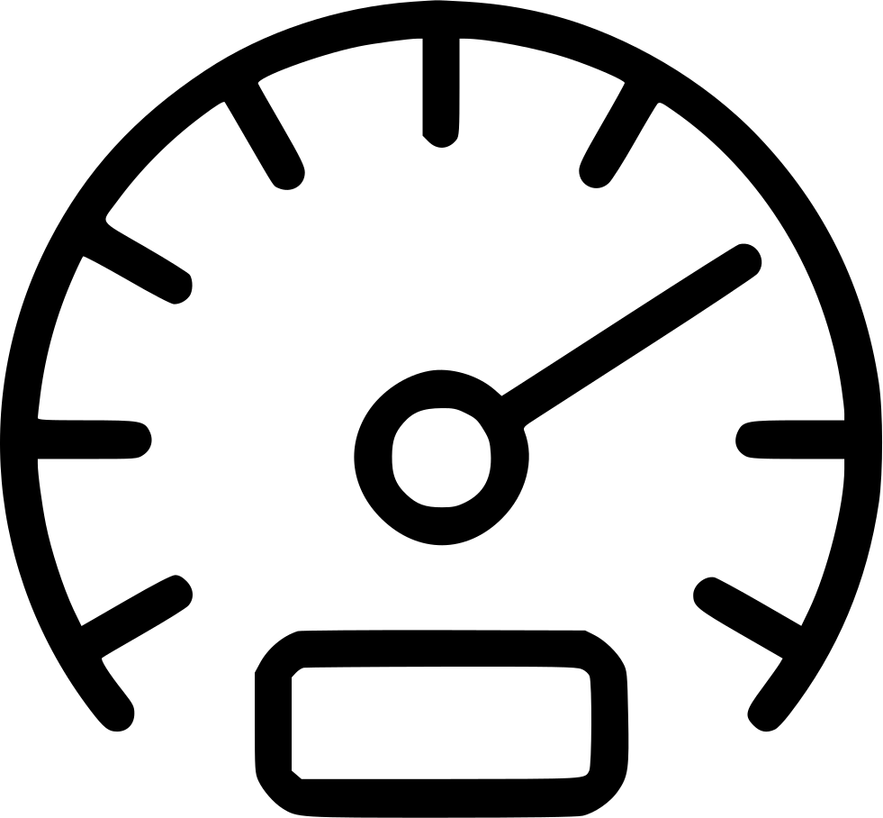
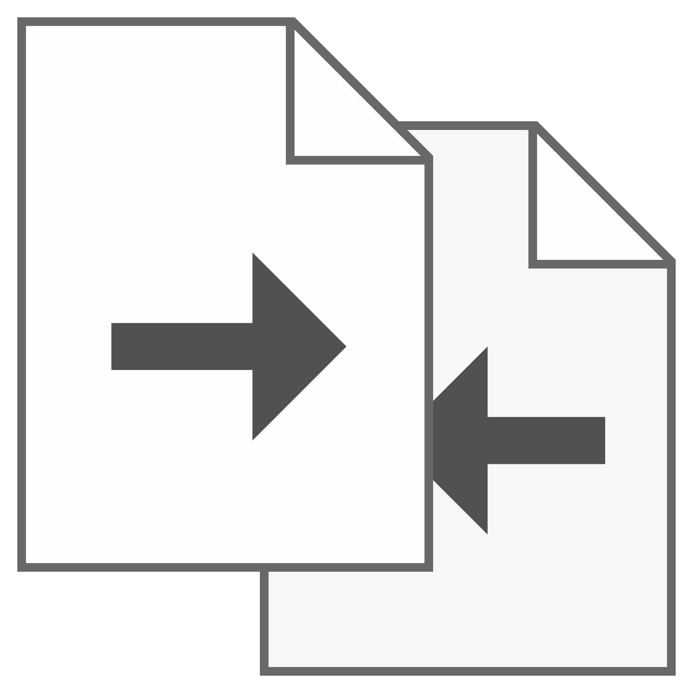

DIFFERENCE BETWEEN CLOUD & PHYSICAL DATABASE
Performance
Maintenance
Reliability
File Sharing
Security

Slide 16
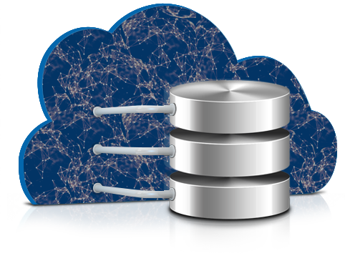
WHAT IS DBaaS?
A cloud database is a database service built and accessed through a cloud platform. It serves many of the same functions as a traditional database with the added flexibility of cloud computing. Users install software on a cloud infrastructure to implement the database.
How to choose a DBaaS
Management tools

Slide 17
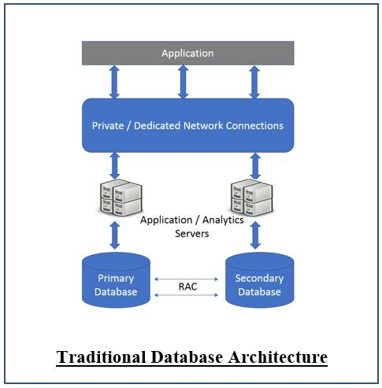
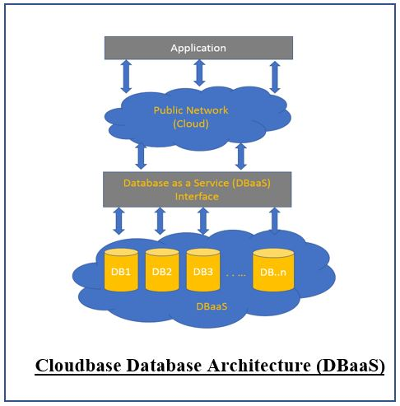
CLOUD DATABASE ARCHITECTURE
Traditional database
DBaaS

Slide 18
DIFFERENCE BETWEEN TRADITIONAL & CLOUD DATABASE
Reliable and private
Limited scalability
Faster but might fail
Deployment takes time
Cost effective and high maintenance
Secured and controlled
Reliable but not necessarily private
Unlimited scalability
Faster and will be always up
Deployment takes no time
Pay only for what we use and no maintenance
Security depends provider

Slide 19
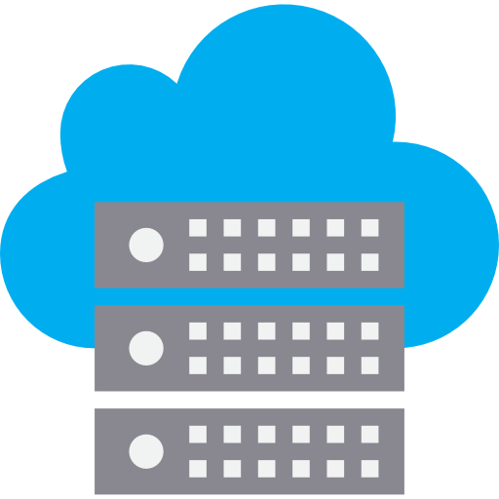
RDBMS in DBaaS
Became popular with the rise of Cloud Computing
Can be considered as SaaS
Provides a layer in between the service and the client
The layer consists of both the security and user friendly interfacing
API handles it all

Slide 20
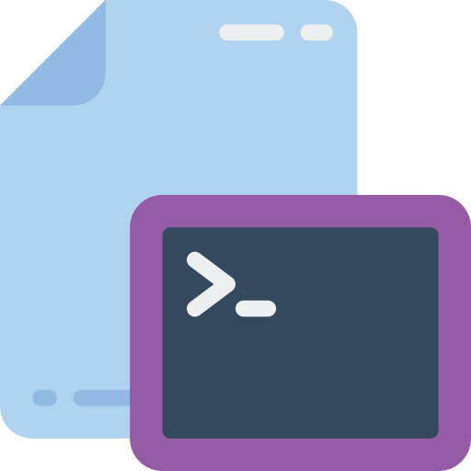
PHYSICAL RDBMS INTERFACE
The terminal to rule them all
SELECT column_name(s) FROM table_name
While the SQL stands for Structured Query Language which is granular enough to provide a user friendly environment, API might feel more developer friendly.

Slide 21
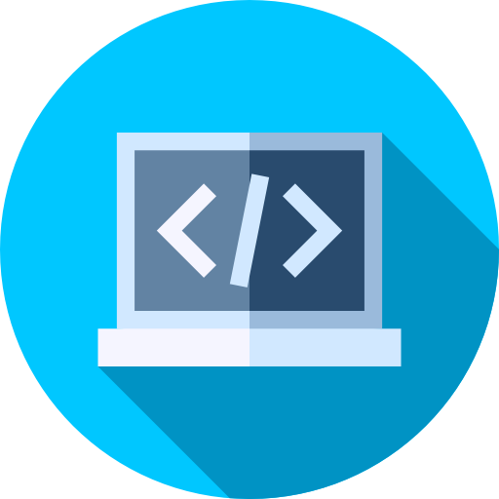
CLOUD RDBMS INTERFACE
The API to rule them all
fetch(“http://dbms.url/user:key/”, {filter: 5})
.then(data => print(data));
Uses the language that developers already know.

Slide 22
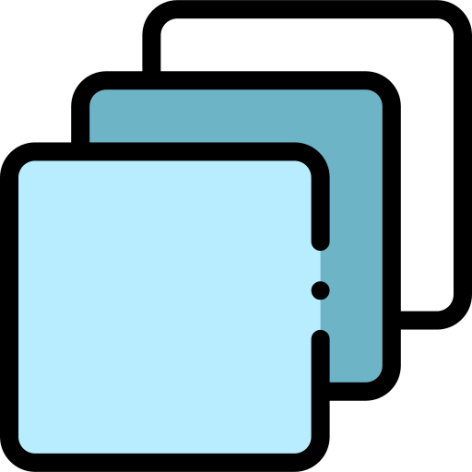
IN BETWEEN LAYERS
The in-between layer is responsible for providing encryption.
It is a software layer that helps the developer with API
Makes the management system more easy with provided graphical web interface

Slide 23

END-TO-END ENCRYPTION
Encryption key lies in the server and in the client side
Encryption handshaking only happens during subscription
Makes it impossible for MiTM Attack

Slide 24
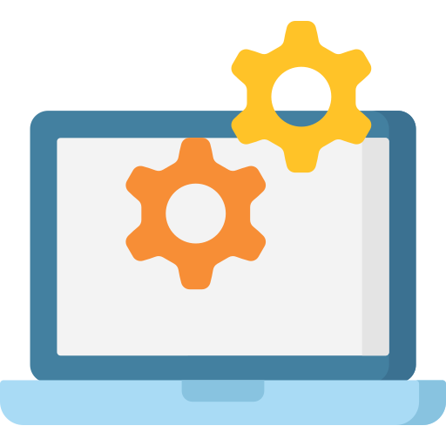
NO-MANAGEMENT
No sysAdmin needed
No CyberSecurity Expert needed
No DB management person needed
No hassle of physical device maintenance

Slide 25
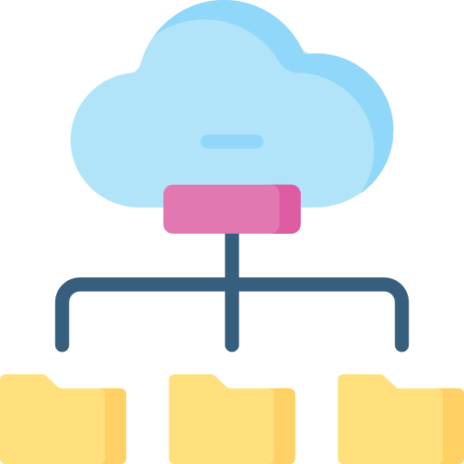
CLOUD RDBMS ARCHITECTURE
Containerization
Virtualization
Singular Security Architecture
Scalable Machine Allocation
Disaster Recovery

Slide 26
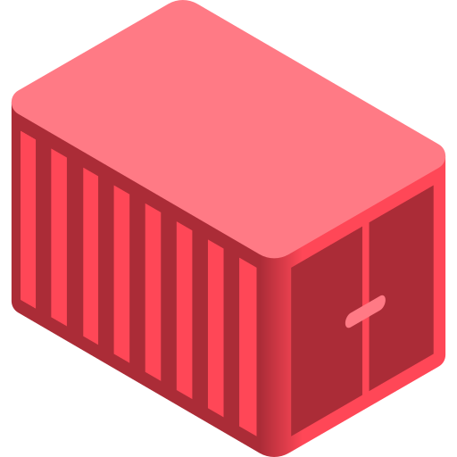
CONTAINERIZATION
Each RDBMS stays inside a container
Makes it easier to deploy or redeploy
Easier to Scale in vertical direction
Much secure than physical RDMS server

Slide 27
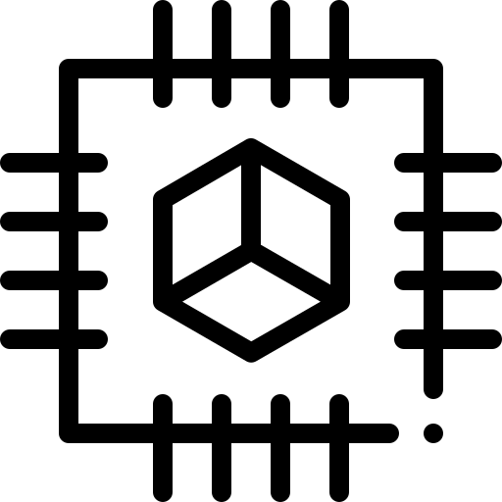
VIRTUALIZATION
Each VM is allocated with specific virtual HW
On demand scaling is available due to its virtualized nature
Vertical Scaling is a breeze in this architecture
User gets more granular control over the usage

Slide 28

SINGULAR SECURITY ARCHITECTURE
Since, all the RDBMS server stays inside one big cluster, it is easier to maintain the security as the security engineer only has to manage the cluster’s security system not individual containers or VMs. All the instances of the RDMS are behind the clusters firewall.

Slide 29
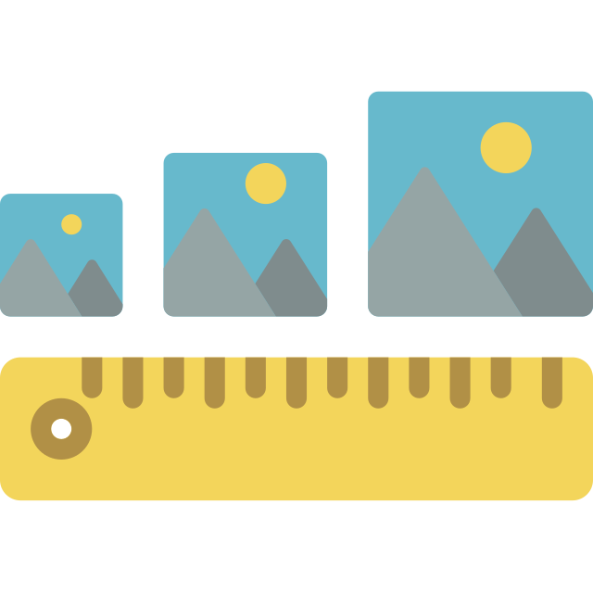
SCALABILITY
RDBMS under the hood is a set of tool to manage RDBS. So, DBaaS is essentially SaaS in broader aspect. A SaaS needs both horizontal and vertical Scaling over the time.
Cloud Computing enables scaling to be easier for both the client side and the servier side.

Slide 30
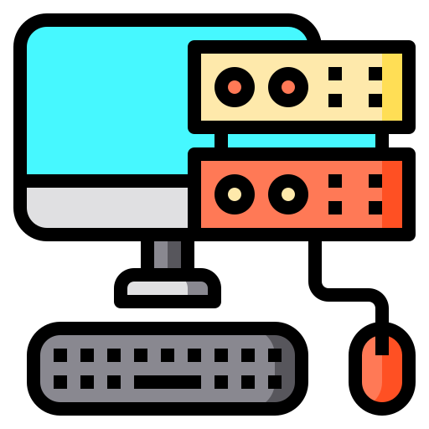
CLIENT SIDE SCALING
One click scaling in client side
Pay as you go subscription
Both vertical and horizontal scaling is possible since it is actually happening in the server.
Maintenance server fallback

Slide 31
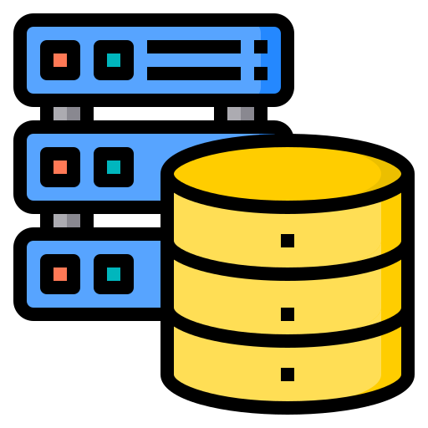
SERVER SIDE SCALING
It is also easier for servers enterprises to scale the service on demand since all the data is standalone from the actual RDBMS server itself.
Horizontal scaling is possible by adding more resources to the system
Vertical scaling is possible just by distributing the loads of containers or VMs over multiple resources

Slide 32
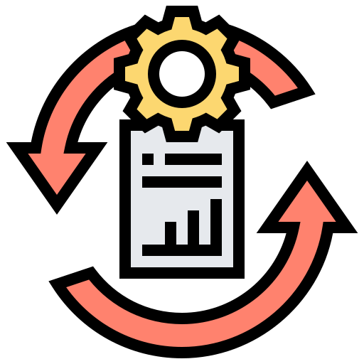
DATA RECOVERY & DISASTER MANAGEMENT
In case of any disaster or data lose, it far more quicker to spin up the server again with backup data, since the main cluster will still be running with a clone of those data. Even during the time of maintenance the servers provide a fallback service to cope-up with the situation.

Slide 33
SKYSQL
MariaDB being one of the leading MySQL fork provides SkySQL DBaaS.
SkySQL provides customers with a single solution for all of their database needs, removing the need to use separate database and data warehouse services
SkySQL makes it easy to start small and scale when needed, as much as needed

Slide 34

FUTURE OF RDBMS in DBaaS
The future of RDBMS heavily depends on the future of cloud computing
Even though non relational DB system getting popular, RDBS is not going anywhere
RDBMS is much harder to exploit than non-RDBMSs
Enterprise and Hobbyists still finds it interesting to use RDBMS over non-RDBMS.

Slide 35
Acknowledge to
TANVIR RAHMAN (19101268)
TANJID AHMED (19101021)

